Slide 1
MONTHLY OPERATIONS REPORT February 2016
Town of Discovery Bay, CA
2373 Days of Safe Operations
107,602 worked hours since last recordable incident

Slide 2
TRAINING: Safety, Operations, & Equipment
Safety | Hours
West Monthly Regional Safety Webinar Weekly Safety Topics Lockout/Tagout | 4.0
Operations
None

Slide 3
REPORTS SUBMITTED TO REGULATORY AGENCIES
Monthly Discharge Monitoring Report (DMR)
Monthly electronic State Monitoring Report (eSMR)
Monthly Coliform Report, California Department of Public Health (CDPH)

Slide 4
WATER SERVICES
# of Active Wells | Water Produced (MG) | Chemical (Hypo) Delivered | Fire Hydrant Flushing
5 | 39 | 895 | 0
Note: Well 5 is off line, Replaced by Well #7
2013 Water Production Table (MG) by Month
January | February | March | April | May | June
40 | 39
July | August | September | October | November | December
Bacteriological Test Results:
Routine Bacteria Samples Collected | No. Total Coliform Positives | No. Fecal/E. coli Positives | Brown Water Calls
16 | 0 | 0 | 0

Slide 5
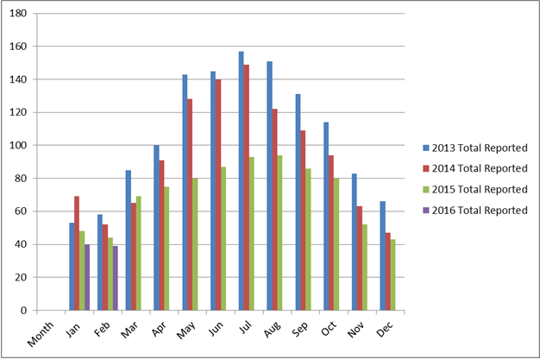
WATER SERVICES

Slide 6
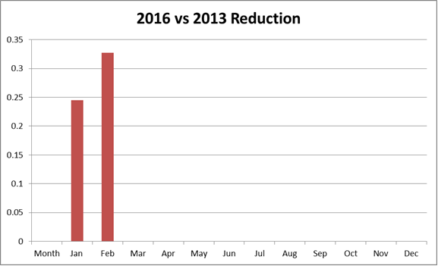
Water Reduction

Slide 7
Water Reduction at Wastewater Plant
Reused #3 Water:
2.0 MG – January
2.2 MG- February

Slide 8
WASTEWATER SERVICE
Wastewater Laboratory Analysis
WW Effluent Parameter | Permit Limits | January Lab Data | Febuary Lab Data
Flow, MG Effluent, monthly total | -------------------- | 36 | 32
Flow, MG Daily Influent Flow, avg. | N/A | 1.3 | 1.2
Flow, MG Daily Discharge Flow, avg. | 2.1 | 1.2 | 1.1
Effluent BOD₅, lbs/d, monthly avg. | 350 | 54 | 46
Effluent TSS, lbs/d, monthly avg. | 525 | 57 | 36
Effluent BOD₅, mg/L, monthly avg. | 20 | 6 | 5
Effluent TSS, mg/L, monthly avg. | 30 | 6 | 4
Total Coli form 7 day Median Max | 23 | 8 | 0
Total Coli form Daily Maximum | 240 | 5 | 2
% Removal BOD₅, monthly avg. | 85% min. | 97 | 98
% Removal, TSS, monthly avg. | 85% min. | 93 | 97
Electrical Conductivity, umhos/cm annual avg. | 2100 | 2060 | 2060

Slide 9
WASTEWATER SERVICE
National Pollution Discharge Elimination System (NPDES)
NPDES Related Excursions | Permit Parameter | NPDES Parameter Limit | Actual Parameter Result
0 | N/A | N/A | N/A
Bacteriological Test Results:
Routine Bacteria Samples Collected | No. Total Coliform Positives | No. Fecal/E. coli Positives | 7-Day Median Excursion
12 | 0 | 0 | 3
# of Active Lift Stations | # of Inactive Lift Stations | SSO | Wastewater Received (MG)
15 | 0 | 0 | 32.3

Slide 10
WASTEWATER SERVICE
COLLECTION:
Flushing resumed 21,315 ft.
CCTV 34,086 ft.
Inspected 77 manhole & covers.
Performed weekly lift station inspections.

Slide 11
GENERAL TRACKING INFO
Preventive and Corrective
Total # of WO’s Completed | Total Hours
273 | 325
Work Order Back-Log
Aging 8 - 30 Days | Aging > 30 Days
28 | 7
Call & Emergency Responses
Call Outs | Emergencies
1 | 0
Personnel Hours & Overtime:
Regular Hours | Overtime
1344 | 37

Slide 12
TERMS
WWTP WASTEWATER TREATMENT PLANT
WTP WATER TREAMENT PLANT
WL WILLOW LAKE
NP NEWPORT
VFD VARIABLE FREQUENCY DRIVE
WO WORK ORDER
PLC PROGRAMMABLE LOGIC CONTROLLER
L/S LIFT STATION
SSO SANITARY SEWER OVERFLOW
BOD BIOLOGICAL OXYGEN DEMAND
TSS TOTAL SUSPENDED SOLIDS
MGD MILLION GALLONS PER DAY
mg/l MILLIGRAMS PER LITRE
CCTV CLOSED CIRCUIT TELEVISION
PPM PARTS PER MILLION
RAS RETURN ACTIVATED SLUDGE
WAS WATSE ACTIVATED SLUDGE
UV ULTRAVIOLET LIGHT

Slide 13
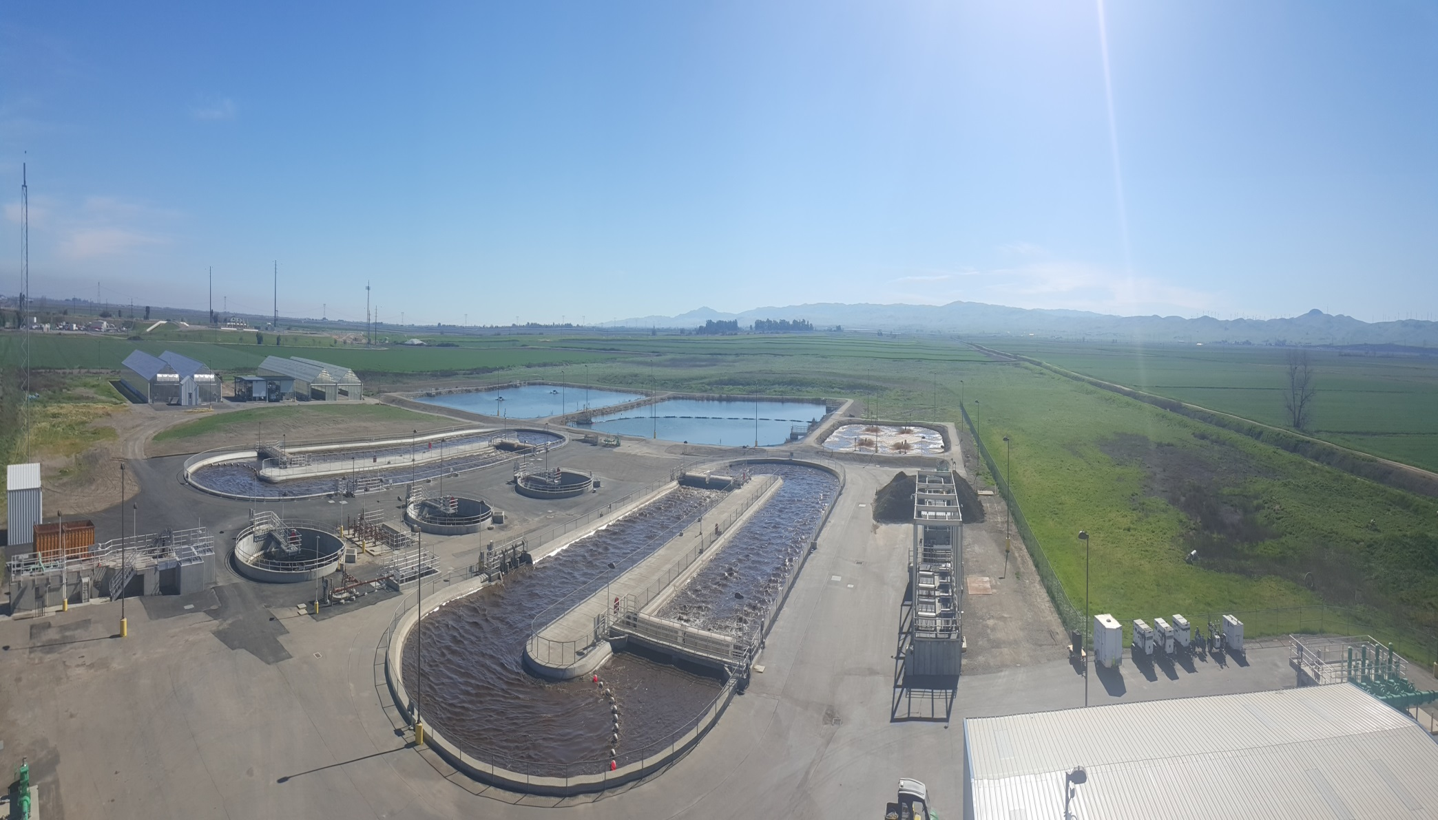
PLANT 2

