Slide 1
Ground Water Sustainability Plan

Slide 2
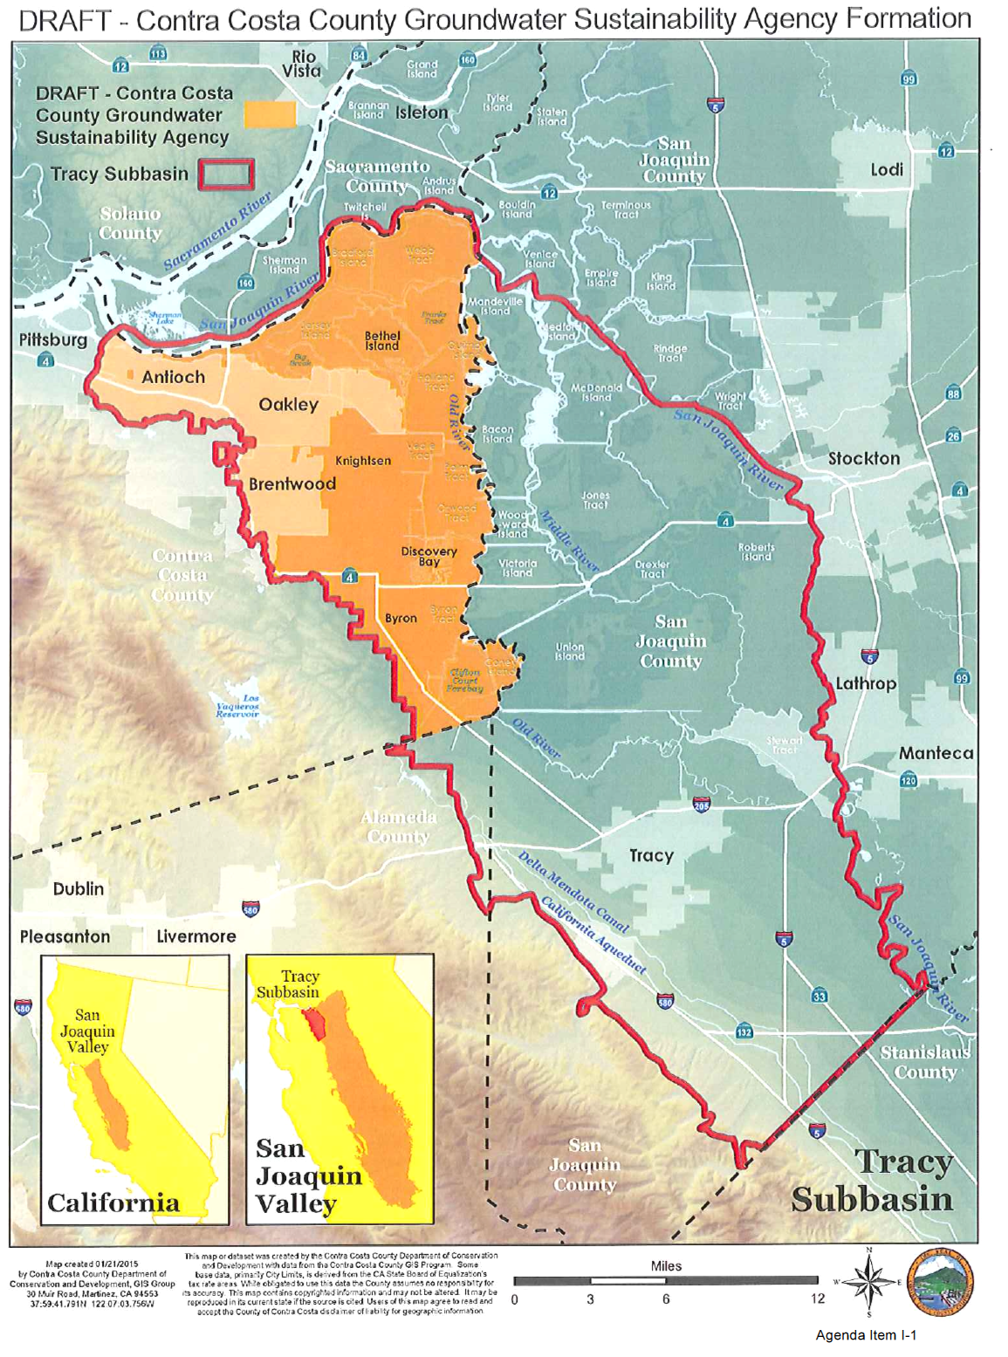

Slide 3
