Slide 1
Town of Discovery Bay
Water and Wastewater
Rate Study
May 4, 2016
BARTLE WELLS ASSOCIATES
Alison Lechowicz
Independent Public Finance Advisors
Vice President

Slide 2
Background
Last conducted a rate study in 2013
Town approved and implemented inflationary increases
Recent developments
Drought – Town’s water conservation target is 29%
New regulatory requirements and capital improvements
Well 8 - $2.1 million
Water meter roll out - $3 million
Wastewater filter project - $7.4 million

Slide 3
Water meter roll out
In FY2017, the Town will install the meters and potentially provide water usage data to customers; customers will continue to pay the unmetered rate
In FY2018, all customers will be metered and pay the metered rates
Meter financing options for customers
Fund meter installation upfront
Finance over period of time

Slide 4
Water Rate Study
Financing costs for well 8
Increased cost due to operations and maintaining current infrastructure
New staff for customer service/billing, and water services technician
Conservation: costs to maintain our current and future infrastructure needs
Unmetered customers currently billed for assumed use of 21 ccf of water. After metering, assumed monthly use of 15 ccf in FY2018 and beyond

Slide 5
Water Rate Option 1
Water Option 1 | Current FY2016 | Proposed FY2017 | Proposed FY2018 | Proposed FY2019 | Proposed FY2020 | Proposed FY2021
$ increase |  | $5.63 | $6.50 | $1.75 | $1.82 | $1.89
Average Bill* | $32.66 | $38.29 | $44.79 | $46.54 | $48.36 | $50.26
% Increase |  | 17% | 17% | 4% | 4% | 4%
* 1-inch residential customer using 15 ccf monthly (approximately 11,200 gallons)
Opt 1 – Water rate option presented Feb 17 Board Meeting
Assumes upfront financing of meters and Well 8
Assumes cash funding of pipeline upsizing to 16” lines ($2M)

Slide 6
Water Rate Option 2
Water Option 2 | Current FY2016 | Proposed FY2017 | Proposed FY2018 | Proposed FY2019 | Proposed FY2020 | Proposed FY2021
$ increase |  | $4.90 | $5.65 | $5.06 | $5.67 | $6.35
Average Bill* | $32.66 | $37.56 | $43.21 | $48.27 | $53.94 | $60.30
% Increase |  | 15% | 15% | 12% | 12% | 12%
* 1-inch residential customer using 15 ccf monthly (approximately 11,200 gallons)
New option with lower early year increases
Upfront financing of water meters
Develops infrastructure reserve of $2.6 million over five years for cash funding of Well 8, or mainline replacements, or paying down debt

Slide 7
Water Rate Option Comparison
Water Option 1 | Current FY2016 | Proposed FY2017 | Proposed FY2018 | Proposed FY2019 | Proposed FY2020 | Proposed FY2021
$ increase |  | $5.63 | $6.50 | $1.75 | $1.82 | $1.89
Average Bill* | $32.66 | $38.29 | $44.79 | $46.54 | $48.36 | $50.26
% Increase |  | 17% | 17% | 4% | 4% | 4%
Water Option 2 | Current FY2016 | Proposed FY2017 | Proposed FY2018 | Proposed FY2019 | Proposed FY2020 | Proposed FY2021
$ increase |  | $4.90 | $5.65 | $5.06 | $5.67 | $6.35
Average Bill* | $32.66 | $37.56 | $43.21 | $48.27 | $53.94 | $60.30
% Increase |  | 15% | 15% | 12% | 12% | 12%
* 1-inch residential customer using 15 ccf monthly (approximately 11,200 gallons)

Slide 8
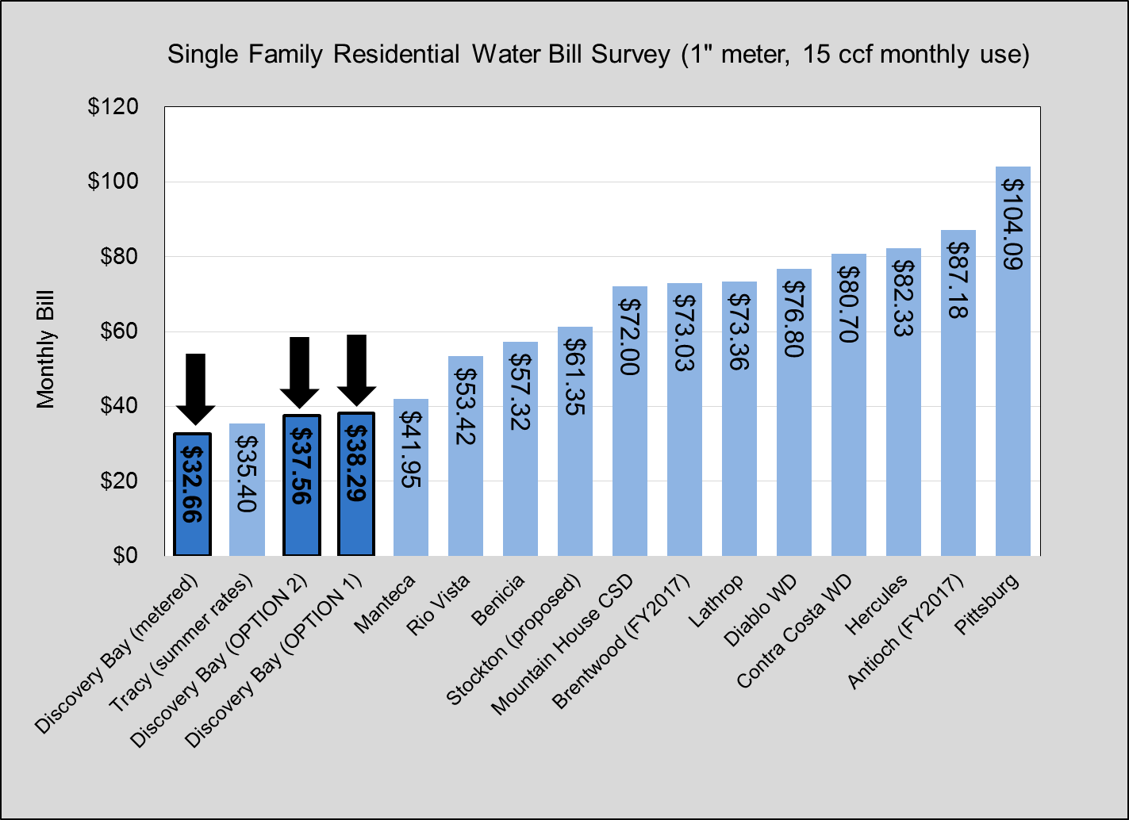

Slide 9
Wastewater Rate Study
Increased cost due to the management and maintenance of sophisticated plant operations
Assumed financing of $7.4 million filter project over 30 years to support the needs of a higher level of treatment
Reduction in metered commercial sewer flow due to drought
Sewer | Current FY2016 | Proposed FY2017 | Proposed FY2018 | Proposed FY2019 | Proposed FY2020 | Proposed FY2021
$ increase |  | $6.81 | $7.56 | $3.05 | $3.18 | $3.30
Average Bill | $61.95 | $68.76 | $76.32 | $79.38 | $82.55 | $85.85
% Increase |  | 11% | 11% | 4% | 4% | 4%

Slide 10
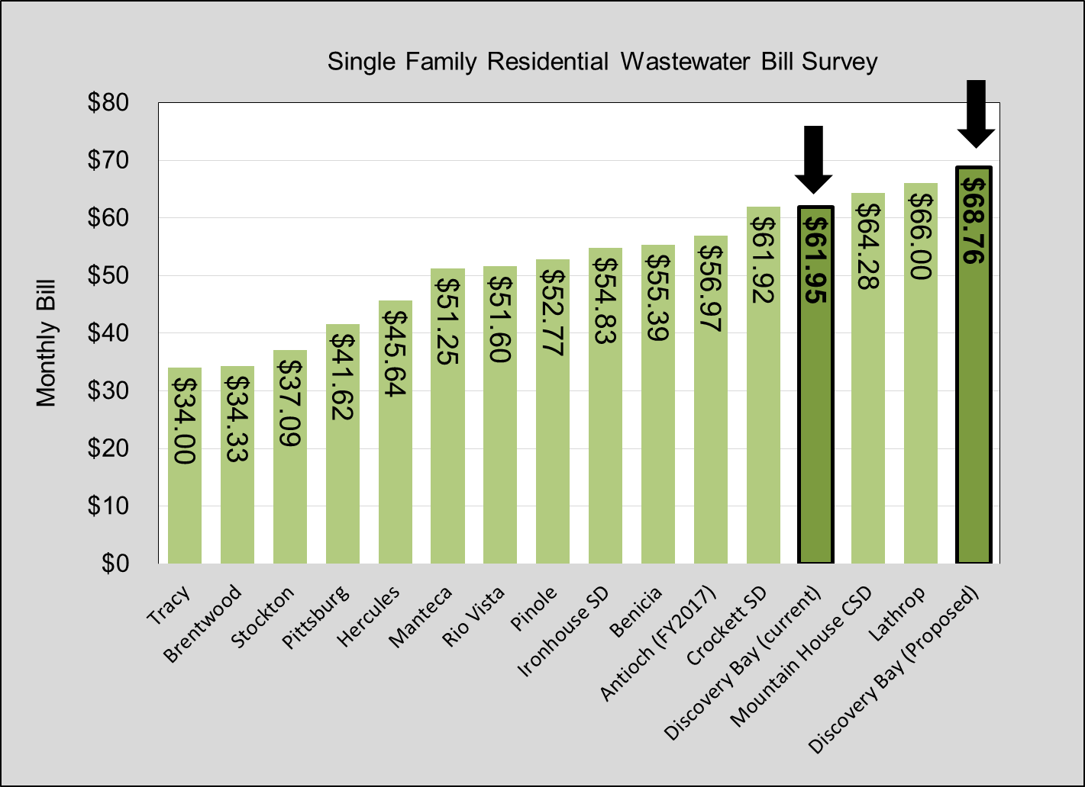

Slide 11
Questions

