Slide 1
WATER CONSERVATION
*Statewide 25% Reduction goal*

Slide 2
Statewide 25% Conservation Goal
Reduction standard set from 8% to 36%
Cumulative Statewide Reduction — 24.8% through January, 2016
1.147 million acre-feet of water saved as compared to the same months (June — January) of 2013
96% toward meeting cumulative savings goal

Slide 3
Communities Achieving Reductions:
411 urban water suppliers
234 or 58% have exceeded or are within 1% of achieving goal;
71 or 18% are 1 to 5% from achieving goal;
88 or 22% are 5 to 15% from achieving goal;
8 are more than 15% from achieving their goal.

Slide 4
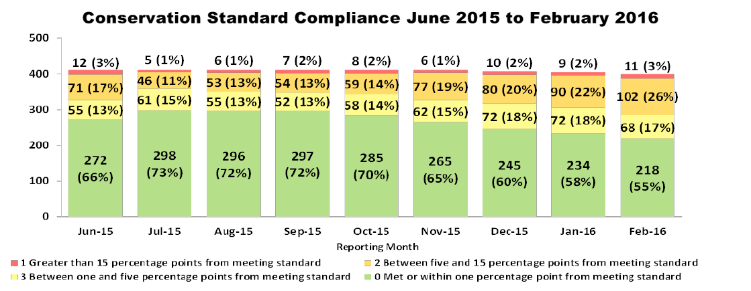
Conservation Compliance
Suppliers reporting by Compliance Priorities

Slide 5
January Conservation:
January 2016 saw the lowest level of water supplier compliance to date with only 58% meeting the standard
Statewide average water use for January was the lowest on record at 61 residential gallons/day.

Slide 6
Water Conservation Water Production Million Gallons (mg) for 2013

Slide 7
Water Conservation
Water Production Million Gallons (mg) for 2013 and 2014

Slide 8
Water Conservation Water Production Million Gallons (mg) for 2013, 2014, and 2015

Slide 9
Water Conservation
Water Production Million Gallons (mg) for 2013, 2014, 2015 and 2016

Slide 10
Water Conservation
Water Production Million Gallons (mg) for 2013, 2014, 2015 and 2016

Slide 11
Discovery Bay Conservation Summary:
June 2015 through January 2016 — 36.2% conservation, exceeding 32% conservation goal;
January conservation was 26.4% measurably better than the region but below the standard.
February conservation was 35.1%

Slide 12
Snow Pack
Reaches peak water content at the beginning of April
Relatively positive snow pack and water content reading
Snowpack depth and water content approximately 87% of average (statewide)

Slide 13
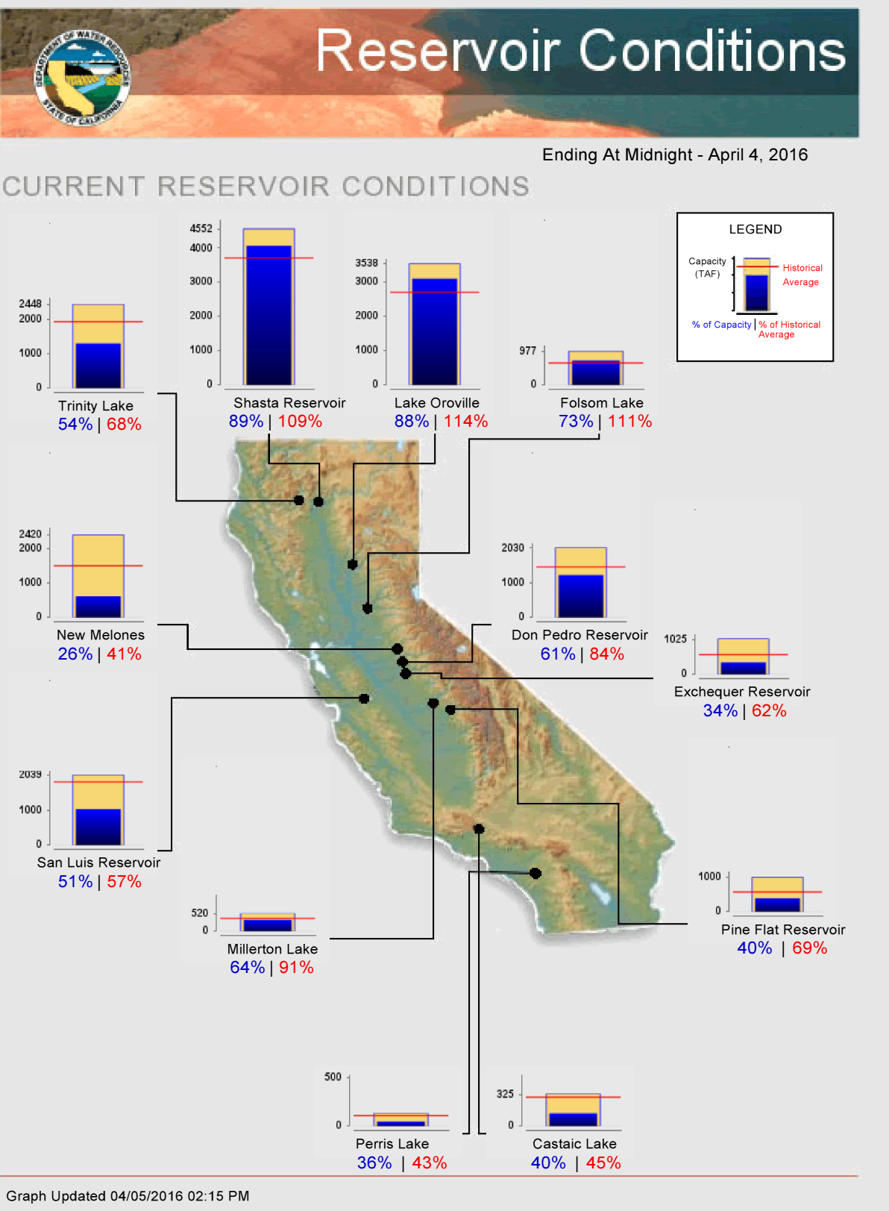

Slide 14
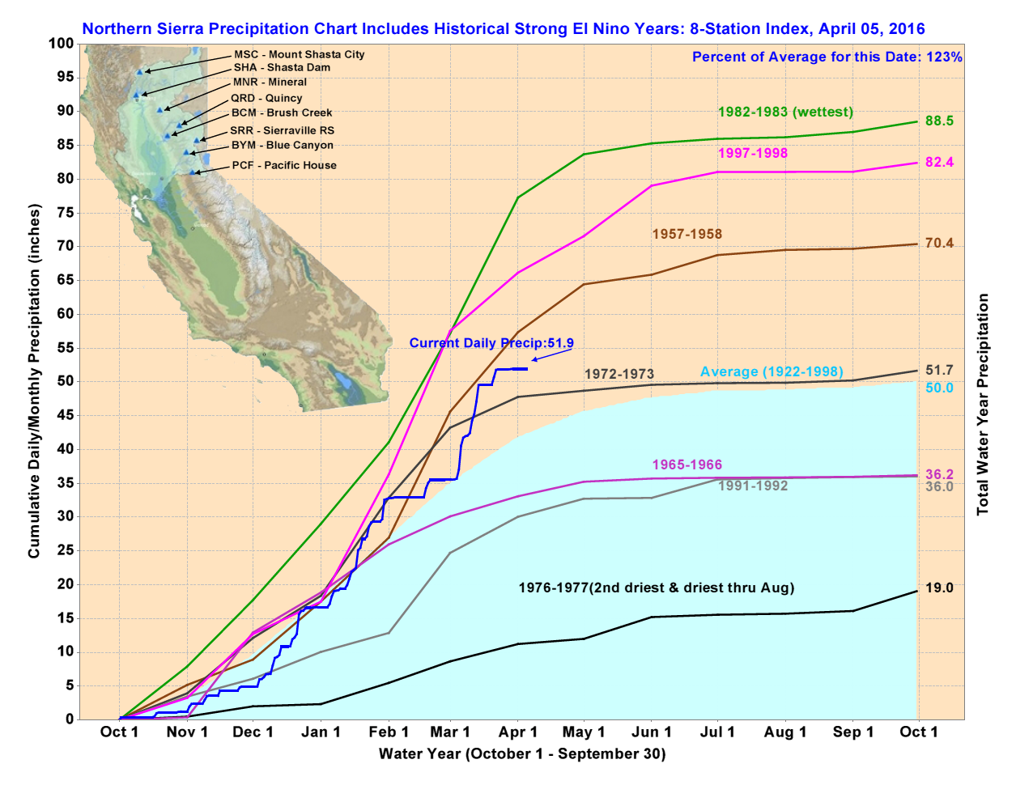
Northern Sierra Precipitation: 8 Station Index
State slide 15

Slide 15
Continuing Drought and Conservation Concerns:
DWR cautions that one reasonable year doesn't undo 4 drought years;
All of Southern California is well below average precipitation;
Groundwater levels throughout the state have dropped to historic lows over the past 4 years.
".. a warm and dry February has proved that we can't count on El Nino to save us. Californians have risen to the occasion as never before. But we have to stay the course. We have to keep it up. (Felicia Marcus, State Water Resources Control Board Chair)

Slide 16
State DWR Workshop Questions:
What elements of the Emergency Regulations should be modified?
How should the state account for regional differences in precipitation?
To what extent should reliability of an urban water supplier affect emergency regulations?

