Slide 1
MONTHLY OPERATIONS REPORT November 2015
Town of Discovery Bay, CA
2284 Days of Safe Operations
103,311 worked hours since last recordable incident

Slide 2
TRAINING: Safety, Operations, & Equipment
Safety | Hours
West Monthly Regional Safety Webinar Weekly Safety Topics Monthly Safety Topics Hearing Testing/Conservation | 4.0
Operations
None

Slide 3
REPORTS SUBMITTED TO REGULATORY AGENCIES
Monthly Discharge Monitoring Report (DMR)
Monthly electronic State Monitoring Report (eSMR)
Monthly Coliform Report, California Department of Public Health (CDPH)

Slide 4
WATER SERVICES
# of Active Wells | Water Produced (MG) | Chemical (Hypo) Delivered | Fire Hydrant Flushing
5 | 52 | 2345 | 1
Note: Well 5 is off line, Replaced by Well #7
2013 Water Production Table (MG) by Month
January | February | March | April | May | June
48 | 44 | 70 | 75 | 80 | 87
July | August | September | October | November | December
93 | 94 | 86 | 80 | 52
Bacteriological Test Results:
Routine Bacteria Samples Collected | No. Total Coliform Positives | No. Fecal/E. coli Positives | Brown Water Calls
16 | 0 | 0 | 0

Slide 5
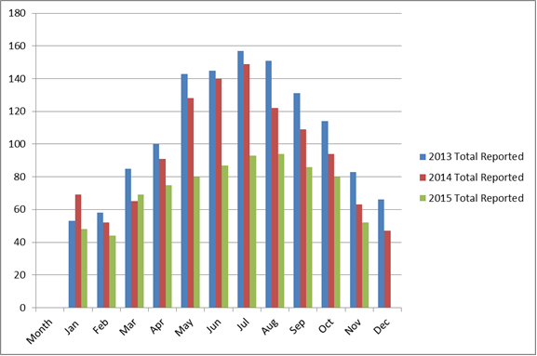
WATER SERVICES

Slide 6
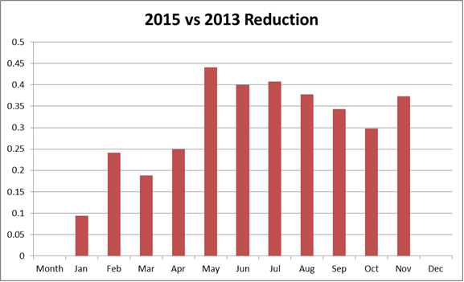
Water Reduction

Slide 7
Water Reduction at Wastewater Plant
Reused #3 Water:
1.3 MG - July
1.9 MG – August
5.4 MG- September
1.2 MG- October
1.7 MG - November

Slide 8
WASTEWATER SERVICE
Wastewater Laboratory Analysis
WW Effluent Parameter | Permit Limits | October Lab Data | November Lab Data
Flow, MG Effluent, monthly total | -------------------- | 33.0 | 32.0
Flow, MG Daily Influent Flow, avg. | N/A | 1.2 | 1.3
Flow, MG Daily Discharge Flow, avg. | 2.1 | 1.1 | 1.1
Effluent BOD₅, lbs/d, monthly avg. | 350 | 16 | 35
Effluent TSS, lbs/d, monthly avg. | 525 | 38 | 42
Effluent BOD₅, mg/L, monthly avg. | 20 | 2 | 3
Effluent TSS, mg/L, monthly avg. | 30 | 4 | 4
Total Coli form 7 day Median Max | 23 | 0 | 0
Total Coli form Daily Maximum | 240 | 2 | 0
% Removal BOD₅, monthly avg. | 85% min. | 99 | 99
% Removal, TSS, monthly avg. | 85% min. | 96 | 94
Electrical Conductivity, umhos/cm annual avg. | 2100 | 2125 | 2158

Slide 9
WASTEWATER SERVICE
National Pollution Discharge Elimination System (NPDES)
NPDES Related Excursions | Permit Parameter | NPDES Parameter Limit | Actual Parameter Result
0 | N/A | 0 | N/A
Bacteriological Test Results:
Routine Bacteria Samples Collected | No. Total Coliform Positives | No. Fecal/E. coli Positives | 7-Day Median Excursion
13 | 0 | 0 | 0
# of Active Lift Stations | # of Inactive Lift Stations | SSO | Wastewater Received (MG)
15 | 0 | 0 | 38.1

Slide 10
WASTEWATER SERVICE
COLLECTION:
Flushing schedule to resume in the fall.
CCTV completed
Inspected 0 Manholes & 0 Covers
Performed weekly lift station inspections.

Slide 11
GENERAL TRACKING INFO
Preventive and Corrective
Total # of WO’s Completed | Total Hours
161 | 4566
Work Order Back-Log
Aging 8 - 30 Days | Aging > 30 Days
41 | 38
Call & Emergency Responses
Call Outs | Emergencies
6 | 0
Personnel Hours & Overtime:
Regular Hours | Overtime
1344 | 29

Slide 12
TERMS
WWTP WASTEWATER TREATMENT PLANT
WTP WATER TREAMENT PLANT
WL WILLOW LAKE
NP NEWPORT
VFD VARIABLE FREQUENCY DRIVE
WO WORK ORDER
PLC PROGRAMMABLE LOGIC CONTROLLER
L/S LIFT STATION
SSO SANITARY SEWER OVERFLOW
BOD BIOLOGICAL OXYGEN DEMAND
TSS TOTAL SUSPENDED SOLIDS
MGD MILLION GALLONS PER DAY
mg/l MILLIGRAMS PER LITRE
CCTV CLOSED CIRCUIT TELEVISION
PPM PARTS PER MILLION
RAS RETURN ACTIVATED SLUDGE
WAS WATSE ACTIVATED SLUDGE
UV ULTRAVIOLET LIGHT

